Slide 1
Synchronization Tools Chapter 6
The Critical Section Problem
Race Conditions
Synchronization Hardware
ISA Support
Semaphores

Slide 2
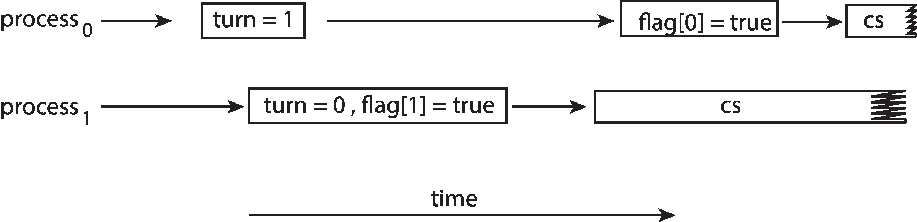
The Effect of Instruction Reordering in Peterson’s Solution
If the assignments made in the first two statements of entry section are reordered
Both threads may be active in their CS at the same time

Slide 3

Hardware Support for Synchronization
Peterson’s solution is a software-based solution
Not guaranteed to work on current architectures
Three hardware instructions that provide support for solving the critical section problem
These primitive operations can be used as synchronization tools
Memory Barriers
Memory model of an application program
How a computer architecture determines what memory guarantees it will provide to an application program
A memory model is in one of two categories

Slide 4
Synchronization Hardware
Strongly ordered
When a memory modification on one processor is immediately visible to all other processors
2. Weakly ordered
When a memory modification on one processor may not be immediately visible to all other processors
Memory models vary by processor type
Computer architectures provide instructions to force any changes in memory to be propagated to all other processors
Memory barrier or memory fences
When a memory barrier instruction is executed

Slide 5
Synchronization Hardware
System ensures that all loads and stores are completed before any subsequent load and store operations are performed
Use a memory barrier operation to ensure the expected output
Hardware Instructions
Solutions to CS problem by using simple hardware techniques or by using instructions available in many architectures
Disable interrupts while a shared variable is being modified in a uniprocessor architecture
Approach taken by nonpreemptive kernels

Slide 6
Memory Barrier
Add a memory barrier to the following instructions to ensure Thread 1 outputs 100:
Thread 1 now performs while (!flag) memory_barrier(); print x;
Thread 2 now performs x = 100; memory_barrier(); flag = true;

Slide 7
Synchronization Hardware
Not a feasible solution in a multiprocessor architecture
System clock will be affected because most system clocks are updated through interrupts
Use special instructions that execute atomically
Execute as one uninterruptible unit
Test and modify a variable
test_and_set() instruction
If two processes execute the instruction at the same time, they will be executed in sequence in some arbitrary order
Used as a solution to the CS problem

Slide 8
test_and_set ( ) Instruction Definition
boolean test_and_set (boolean *target)
{
boolean rv = *target;
*target = true;
return rv;
}
Notes:
8

Slide 9
Solution using test_and_set ( ) – structure of Pi
do {
while ( test_and_set (&lock ))
; /* do nothing */
/* critical section */
lock = false;
/* remainder section */
} while (true);
Notes:
9

Slide 10
Synchronization Hardware
compare_and_swap () instruction operates on two words atomically
Operates on three operands
Mutual exclusion through the use of compare_and_swap() instruction
A global Boolean variable lock is initialized to 0
First process that invokes the instruction sets the lock to 1
Both the algorithms satisfy the mutual exclusion requirement
Bounded-waiting requirement is not satisfied

Slide 11
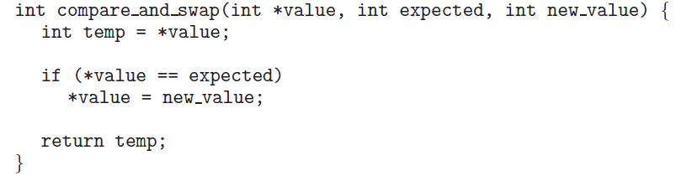
The definition of compare_and_swap () Instruction
Notes:
11

Slide 12
Mutual exclusion implementation with compare_and_swap () instruction
while (true){ while (compare_and_swap(&lock, 0, 1) != 0)
; /* do nothing */
/* critical section */
lock = 0;
/* remainder section */
}
Notes:
12

Slide 13
Synchronization Hardware
Another algorithm using compare_and_swap() instruction and common data structures
boolean waiting [n]; initialized to false
int lock; initialized to 0
Satisfies all the three CS requirements
All the algorithms depend on the implementation of the instructions atomically
Implementation is not a trivial task on multiprocessors
Other relatively simpler solutions are desired

Slide 14
Bounded-waiting Mutual Exclusion with compare_and_swap()
while (true) { waiting[i] = true; key = 1; while (waiting[i] && key == 1)
key = compare_and_swap(&lock,0,1);
waiting[i] = false;
/* critical section */
j = (i + 1) % n;
while ((j != i) && !waiting[j])
j = (j + 1) % n;
if (j == i)
lock = 0;
else
waiting[j] = false;
/* remainder section */
}

Slide 15
Mutex Locks
Hardware based solutions are complex
Inaccessible to application programmers
OS designers build higher level software tools to solve the CS problem
mutex locks
Use mutex lock to protect the CS
Prevent race conditions
Mutex lock structure
Uses boolean variable ‘available’ that indicates whether the lock is available or not
Acquire() and release() functions
Call to acquire() and release() functions are atomic

Slide 16
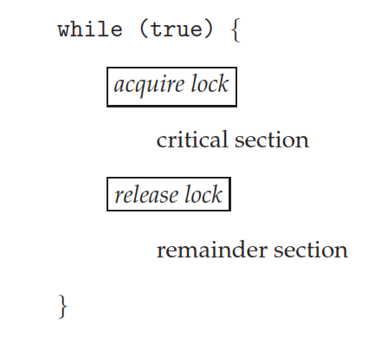
Solution to CS problem using Mutex Locks

Slide 17
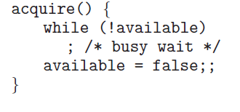
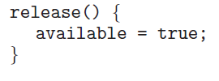
Acquire and release definitions

Slide 18
Mutex Locks
Main disadvantage of implementation is that it requires busy waiting
Mutex lock is also called spinlock
Process spins while waiting for the lock to become available
This would cause problems in real multiprogramming systems because the CPU is not available for other programs
Advantage of busy waiting
No context switch is required in spinlocks
Spinlocks are useful when locks are to be held for a short time
Current generation (multicore processors) prefer the spinlock technique
A widely used technique

Slide 19
Semaphores
Mutex are the simplest synchronization tools
A more robust tool that provides more sophisticated ways for processes to synchronize
A semaphore S is an integer variable that can be accessed only through two atomic operations
wait() and signal()
The wait() operation was originally termed as P (proberen (Dutch): to test)
The signal() operation was termed as V
(verhogen: to increment)
Definitions of wait() and signal()
Both the operations should be performed indivisibly
Mutual exclusion is also required

Slide 20
Semaphore
Definition for wait()
wait (S) {
while (S <= 0)
; // busy wait
S--;
}
Definition for signal()
signal (S) {
S++;
}
Notes:
20

Slide 21
Usage of Semaphores
Counting semaphores
The value can range over an unrestricted domain
Can be used to control access to a given resource consisting of a finite number of instances
Counting semaphores are initialized to the number of resources
Binary semaphores
The value can range only between 0 and 1
Also referred to as mutex locks
Locks that provide mutual exclusion
Binary semaphores are used to deal with the CS problem for multiple processes
Semaphores can also be used to solve various synchronization problems

Slide 22
Usage of Semaphores
In counting semaphore, each process that wishes to use a resource
Performs a wait( ) operation
The process performs a signal( ) operation when it releases the resource
For synchronization problems
P1 with a statement S1 and P2 with a statement S2
S1; wait (synch);
signal (synch) S2;
Synch is initialized to zero
Notes:
22

Slide 23
Implementation of Semaphores
Requirement of busy waiting is the main disadvantage with the semaphore definition
This keeps the CPU busy while the semaphore is in spinlock
The definition of wait() and signal() operations are modified to overcome busy waiting
A process blocks if the semaphore value is not positive
CPU can be allocated to another process
When a signal() is executed on the semaphore, the process is restarted by a wakeup() operation
Process moves into ready state
Block() and wakeup(P) are basic system calls
This implementation may have negative semaphore values – magnitude indicates the number of processes waiting on that semaphore

Slide 24
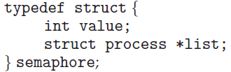
Semaphore Implementation with no Busy waiting
wait(semaphore *S) {
S->value--;
if (S->value < 0) { wait() operation
add this process to S->list; re-defined
block();
}
}
signal(semaphore *S) {
S->value++; signal() operation
if (S->value <= 0) { redefined
remove a process P from S->list;
wakeup(P);
}
}
Notes:
24

Slide 25
Implementation of Semaphores
The list of waiting processes can be implemented by a link field in each PCB
Each semaphore has an integer value and a pointer to a list of PCBs
Requirement of wait() and signal() operations executing atomically still exits
Inhibit interrupts in a uniprocessor architecture
Multiprocessors must provide alternative locking technique – compare_and_swap() or others
Busy waiting has not been completely eliminated
Moved it from the entry section to the critical sections of the application programs

Slide 26
Liveness
Implementation of a semaphore with a waiting queue may result in an indefinite wait among processes
Violates two of the three criteria that the CS problem solution must satisfy
Progress and bounded waiting
Liveness
Refers to a set of properties that a system must satisfy to ensure that the active processes make progress
Liveness failure may be caused by
A process waiting indefinitely
Two situations that can lead to liveness failure
Deadlock and priority inversion

Slide 27
Deadlock
A situation where two or more processes are waiting indefinitely for an event that can be caused only by one of the waiting processes
Execution of a signal () operation
The processes are said to be deadlocked
P₀ P₁
wait (S); wait (Q);
wait (Q); wait (S);
. .
. .
signal (S); signal (Q);
signal (Q); signal (S);

Slide 28
Deadlocks and Starvation
This happens when every process in a set is waiting for an event that can be caused only by another process in the same set
Events are acquisition and release of resources such as mutex locks and semaphores
Indefinite blocking or starvation:
Takes place due to processes waiting indefinitely within the semaphore
Notes:
28

Slide 29
Priority Inversion
A scheduling challenge
A higher priority process needs to read or modify kernel data that are currently being accessed by a lower priority process
The problem is referred to as priority inversion
May occur in systems with more than two priorities
Solution
Have only two priorities
Insufficient for most general purpose OS
Solution
Use priority-inheritance protocol
All processes that are accessing resources needed by a higher priority process inherit the higher priority until they are finished with the resource

Slide 30
Priority Inversion
Three processes L, M and H where L < M < H
H requires access to R
R is being used by L
M becomes runnable and it preempts L
Problem:
H is affected by M although M is of lower priority
Priority-inheritance protocol
L will inherit the priority of H till it is finished with R
Relinquishes its priority at the release of R
H would use R next

